Slide 1
SECURE DATA HIDING IN IMAGES USING STEGANOGRAPHY
CAPSTONE PROJECT
Presented By: Suraj Shinde
College Name & Department : PES College of Engineering, Chhatrapati Sambhajinagar

Slide 2
OUTLINE
Problem Statement
Technology used
Wow factor
End users
Result
Conclusion
Git-hub Link
Future scope

Slide 3
Problem Statement
Data Privacy Risks – Sensitive information needs secure transmission to prevent unauthorized access.
Encryption Visibility – Encrypted files are easily detectable, making them targets for attacks.
Steganography Solution – Hiding data in images ensures confidentiality without raising suspicion.
Detection and Robustness – The method must resist detection, compression, and resizing while maintaining image quality.
Efficiency and Implementation – The system should optimize security, image quality, and embedding capacity for practical use.

Slide 4
Technology used
Programming Language – Python (for image processing and steganographic algorithms).
Image Processing Library – OpenCV / PIL (Pillow) (for manipulating images).
Steganography Techniques – LSB (Least Significant Bit) Encoding, DCT (Discrete Cosine Transform), or DWT (Discrete Wavelet Transform).
Cryptography – Python Cryptography Library / PyCryptodome (for optional encryption before embedding).

Slide 5
Wow factors
Undetectable Data Hiding – The steganography technique ensures that hidden data remains invisible to the human eye and undetectable by basic steganalysis tools.
Dual-Layer Security – Combining steganography with encryption (AES, RSA) enhances security, making data extraction nearly impossible without the correct decryption key.
Resistance to Image Processing – The hidden data remains intact even after image compression, resizing, or format conversion, ensuring robustness.
High Embedding Capacity – Optimized algorithms allow more data to be stored without noticeable changes in image quality.
Real-time Extraction & Validation – A fast and efficient extraction process with validation ensures secure and seamless retrieval of hidden data.

Slide 6
End users
Cybersecurity Professionals & Ethical Hackers
Government & Intelligence Agencies
Journalists & Whistleblower
Military & Defense Organizations
Corporate & Business Executives
Forensic Investigators
Privacy Enthusiasts & Activists

Slide 7
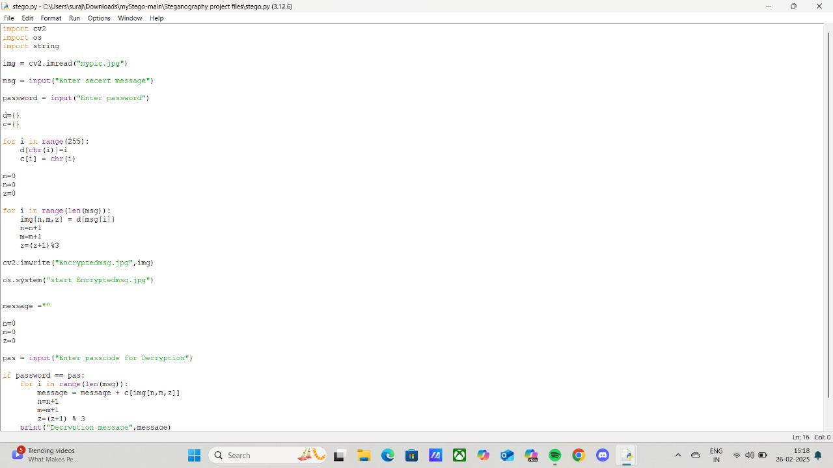
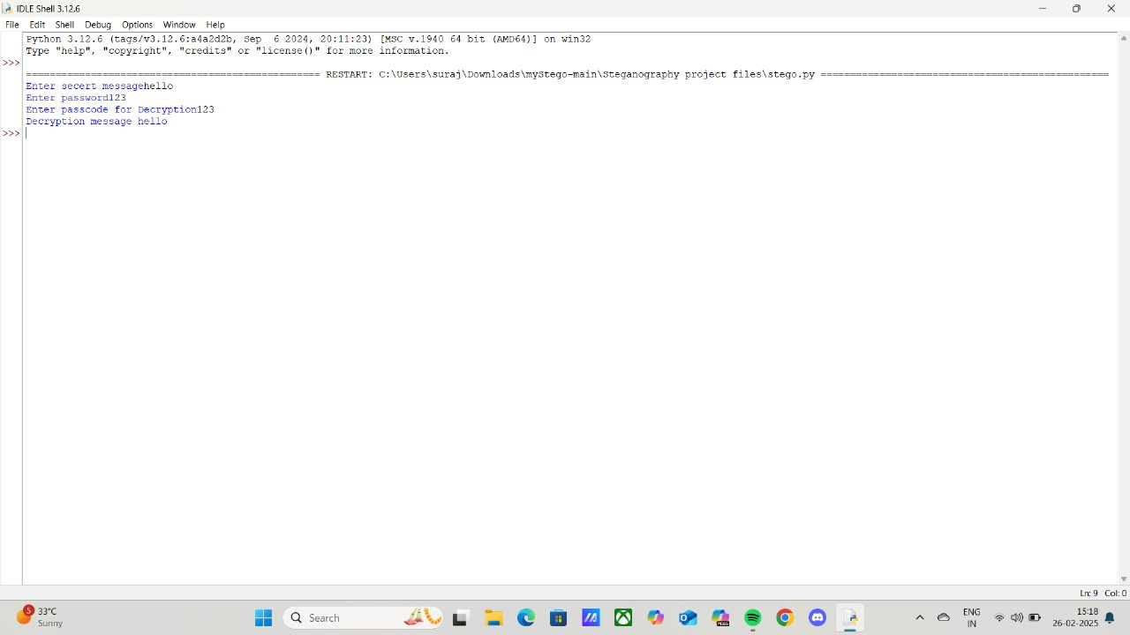
Results

Slide 8
Conclusion
The project Secure Data Hiding in Images Using Steganography effectively addresses the challenges of secure data transmission by providing an undetectable method for embedding sensitive information in images. Unlike traditional encryption, which can attract attention, steganography ensures covert communication while maintaining image integrity. By implementing robust techniques resistant to compression, resizing, and steganalysis, the system enhances both security and practicality. This solution balances data privacy, efficiency, and robustness, making it a valuable tool for cybersecurity, intelligence, and secure digital communication.

Slide 9
GitHub Link
https://github.com/surajjshinde/AICTE-project.git

Slide 10
Future scope(optional)
Advanced Steganography Techniques
Real-time Steganalysis Resistance
Multi-layered Security
Cross-Platform Steganography
Cloud & IoT Integration
Mobile Application Development
Forensic & Cybersecurity Applications

Slide 11
THANK YOU

